Slide 1
Path selection
Packet scheduling and multipath
Sebastian Siikavirta and Antti Mäkelä @ aalto

Slide 2
Multipath path selection
Topics in this presentation
Path forming (which path to create, 1st step of selection)
Multipath load balancing (scheduling for mp routing)
Study ongoing: reordering (reason to choose/not path)
Notes:
This is summary of my research. In this presentation I focus mostly on single flow path selection due my current research.
This presentation is basically summary of two papers, one submitted and one I’m currently writing.

Slide 3
Multipath between networks
Multipath between routers, e.g. private network gateways
Transport flows remain end host to end host
Assumption: path metrics are known by probing/admins
We assume that the first and last hops are the bottleneck
Notes:
Our first step was to connect private networks together with multipath.
How to do it
Compare different algos for scheduling
Machines at the private network connect through gateway. This gateway has several outbound interfaces to connect internet.
Now we want to have multipath between two networks over Internet, example to connect two offices over multipath.
We assume that in this setup the bottleneck is the first hops from the gateway and there’s no congestion in the core network.
We created implementation in three embedded Alix routers and transferred TCP from node to node.

Slide 4
Path forming
Initial selection which path to create between nodes
Full mesh: n*(n-k) paths
  N is node count
  k is interface count per node
Example with 3 nodes, 2 interfaces each: 24 paths
Notes:
Before we can transmit data, we have to decide which kind of paths we are going to create between nodes.
In our setup we can assume that the admin are well aware the metrics, such as bandwidth of their outbound internet connections.
There are multiple ways of forming the paths, example full mesh, where there is path from each interface to every interface in other nodes.
Example this picture here, three nodes with 2 interfaces in each. Full mesh setup would have 12 bidirectional paths or 24 paths single direction paths.
It’s better to think single direction paths, due to the fact that the consumer prices internet connections are asymmetric.
Well, this is not optimal, due we have competing paths from one node to another. Thus we wanted to create algorithm which tries to utilize all bandwidth with minimal path count.

Slide 5
Path forming
A=source interface with most free upload capacity
B=target interface with most download capacity
Add path A->B to path list, with weight min(A,B)
Decrease A and B with min(A,B)
If free upload capacity from source AND free download capacity at target GOTO 1
Pareto-optimal solution
Max. paths = 2nN - N² - 2n + N, where
  n interfaces count
  N node count
Notes:
Thus we created this simple algorithm which aggregates all bandwidth with minimal path setup.
We proved in publication that this is pareto optimal, thus adding a path would not give us more bandwidth and removing any path would always give us less bandwidth.
The proofing was the hard part here.
Basically this algorithm creates path between interfaces which had most capacity and if receiver download or sender upload capacity is aggregated by path, then the setup is ready.

Slide 6
Path forming
Less redundancy, more volatile
No competition by our own paths
Notes:
And here we have simple example. Three nodes with two symmetrical internet connections in each.
Example this setup would aggregate all bandwidth with less paths than the full mesh.
And it’s easy for humans to see, that removing any path would give us less bandwidth.
Anyway, the first step, forming paths between nodes is now possible so let’s move little bit more challenging topic…

Slide 7
Scheduling
Path selection: which path to send next packet in buffer
Comparison of
  Packet based (weighted round robin)
  Flow based (hash from 5-tuple)
Measurement:
  1-64 TCP flows
Notes:
Next we wanted to compare how we should do the load balancing between nodes.
There are two totally different class of scheduling. Flowbases and packet based.
Flowbased are simple load balancing algorithms to dictribute original TCP flows to different path. So one TCP flows in routed through on path.
Bandwidth aggregation happens only when there are multiple TCP flows.
Another is the real multipath, where we schedule the traffic per packet basis.Thus even one TCP flow is distributed to multiple paths.
We compared these two scheduling by putting Spirent testcenter to generate the traffic. We did test different path setup and different amount of TCP flows.
Because I only have small amount of time here, I will only say couple of words about the flow based and focus on the packet based algos.

Slide 8
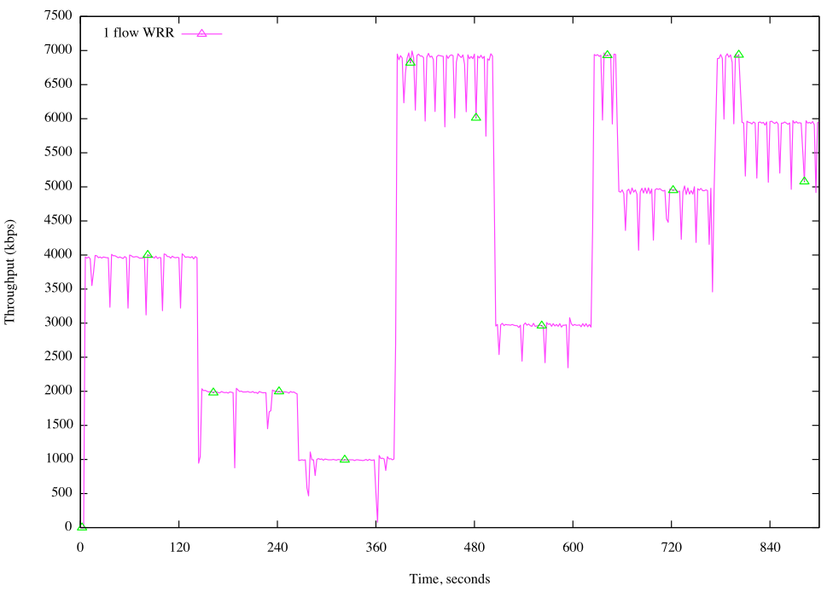
Results: Aggregation
One TCP flow aggregated to three paths with weighted round robin
One way latency 12 ms, jitter 3 ms
Paths: 4 Mbps, 2 Mbps, 1 Mbps
Setups: [4, 2, 1, 4+2+1, 2+1, 4+2+1, 4+1, 4+2+1, 4+2]
Notes:
Here’s bandwidth aggregation when there is only one TCP flow(selective ack) and quite different path setups.
The results for the 4+2+1 is actually almost 7 mbs but this is due the fact that our guess what’s the bandwidth of the interfaces is perfect.
We also tested the how much the actual wrong prediction affects the setup and it was usually the error percentage time the path count when the estimation was off by little.

Slide 9
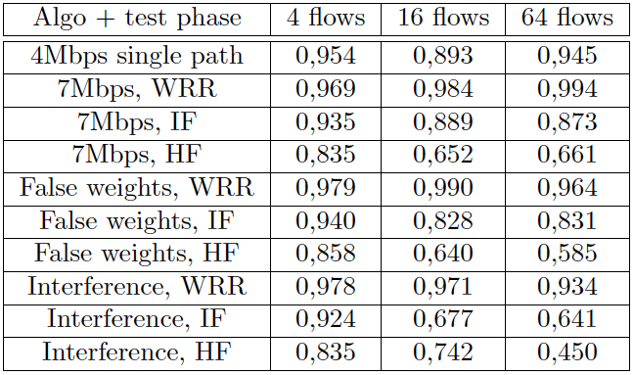

Results: Fairness
Jain's fairness index:
x_{i} throughput of flow, n number of flows
Notes:
We wanted to test the fairness.
So we run multiple TCP flows and calculated how much bandwidth they were able to get during transmission.
We have here 4, 16 and 64 competing TCP flows.
The second to fourtch lines are interesting.
Second line is the packet based algorithm
And third and fourth line are the flow based algorithms.
We had two flow based algorithm. One with simple hash based function to distribute the flows and the intelligent one that distributes the flows to where there is most bandwidth available.
Actually the graph next slide gives a better picture what’s happening.

Slide 10
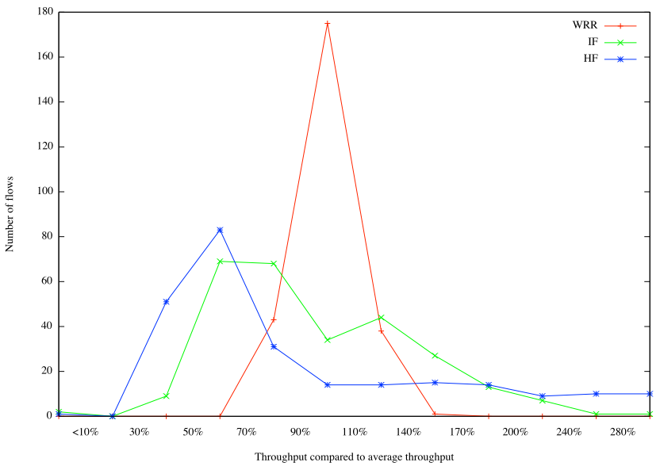
Results: Fairness
WRR: packet based scheduling, weighted round robin
IF, HF: flow based load balancing, hash and intelligent
64 simultaneous flows
Notes:
Around 300 TCP flows all together.
Packet based scheduling is clearly most fair.
So, with packet based algos everybody suffers from the congestion and each other.
With flow based it depends whatkind of traffic you have with you.
Though, it’s interesting that even with 64 flows with 3 paths the flow based are not fair.

Slide 11
MP load balancing results
Packet based solution
  Packet based solutions are fair
  Bandwidth aggregation better when few flows(<8)
Flow based solutions
  If enough flows(≥8) best bandwidth aggregation
  Not as fair as packet based.
  Does not aggregate bandwidth with one flow
  Bandwidth aggregation problem when only one flow.
  RTT fluctuation causes reordering
  Bandwidth fluctuation causes wrong ratios
  Submitted to Elsevier Computer Networks Journal: Comparison of load balancing approaches for multipath connectivity, Mäkelä, Siikavirta, Manner
Notes:
The probing part is important: when distributing one tcp flow to several paths, the tcp jcongestion control can’t handle the paths.
End note here: multipath load balancing is easy for lot of flows, we can virtually aggregate all bandwidth with flow based solutions without reordering
The question is what about striping few or single flow to multipath?

Slide 12
Ongoing study
  How multipath affects single transport flow in general?
Problem 1: RTT fluctuation and reordering
Problem 2: Bandwidth aggregation not optimal
Problem 3: Path forming based only bandwidths
Notes:
So this is the last part of this presentation. Now we have good picture that the single flow multipath is less than optimal
My guess for the reasons are: reordering and bandwidth fluctuation.
To overcame the negative effects of the multipath for single flow we have to understand the negative effect.
Causes delay, receive windows grow,
Reordering is quite definitely a causes here, so first the reorder has to be modeled. Another issue is bandwidth probing.
3. If we know the path metrics and these models we can
Decide which paths to use
What’s the benefit of this study?
To better understand when to use paths
e.g. WLAN and cellular links: use both or just another?

Slide 13
Modeling reordering
How much reordering we have because of multipath?
How much delay packet reordering causes?
What are the effects of adding paths
Current study
  Models of the reordering and delay when path metrics are know
  Simulate models with different network setup
  Test implementation with real networks
Notes:
So my study continues with reordering, especially because we didn’t use this knowledge for path forming.
RTT is important metric when dealing with single flow
Causes: e.g. receiving window size, thresholds for fast retransmission and dupacks
Known by probing, database of statistics or by setting them by hand by administrators. In future the probing mechanism are studied.

Slide 14
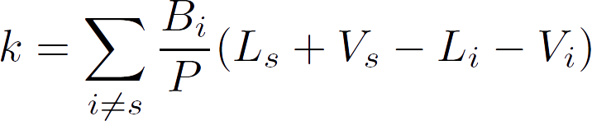
Reordering distance
Amount of packets that are received before the one the receiver is waiting for?
Notes:
More the distance, more we need receive window.
Also e.g. feedback is less effective, due we have to wait at least average distance before duplicate acks.

Slide 15
Thank you!
Notes:
I want to get results that should be usable for any transport research and mptcp researh.

