Slide 1
Economics of stub network multihoming and link load balancing INTERIM RESULTS AND NEXT STEPS
Henna Warma
Aalto University - COMNET
December, 7th 2011

Slide 2
Agenda
Motivation
Network design and implementation
Multihoming and link load balancing
Challenges
Economic considerations
Next steps

Slide 3
Motivation
To better understand the potential multipath protocols we should have more knowledge on companies’
decision-making processes of network investments
motivations to do multihoming and load balancing
Technical comparisons [1,2] and measurements [3] of different multihoming solutions exists
Lack of economical understanding in which contexts these solutions are used
What challenges and opportunities are related to them
Multihoming and load balancing concepts are being used vaguely in the literature
Separate and clarify terminology

Slide 4
Interviews
Mainly Finnish companies
Completed interviews
3 content providers
2 operators
1 hosting provider
2 equipment vendors
Still few to come (hopefully)
Medium-sized companies
Companies with extremely high availability requirements

Slide 5
Multihoming as a part of network solution
Stub networks need high-availability
Multihoming is not an absolute value but a common way of implementing local connectivity redundancy cheaply
Site traffic classification
Site-to-consumer (S2C)
Site-to-business (S2B)
Site-to-site (S2S)
Internet-to-site (I2S)
Network solution
Service availability
Costs
Usability
Security
Traffic characteristics

Slide 6
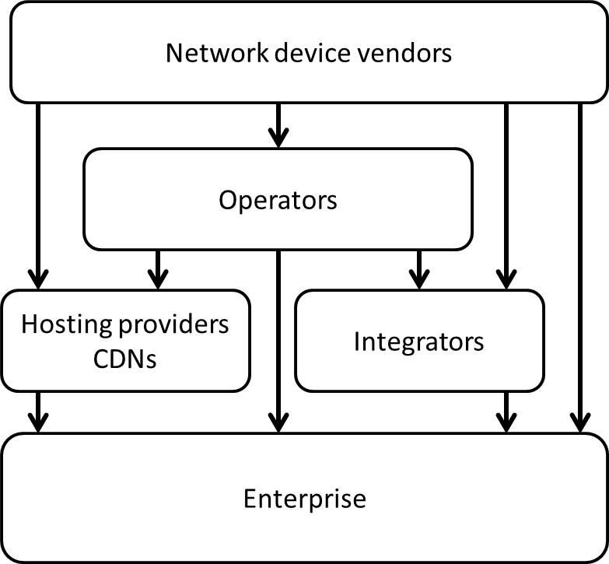
Mixture of players
Who designs and implements the network?
Enterprise itself
External consultant
Operator
Integrator
Who delivers the content?
Enterprise itself
Hosting provider
CDN provider
Modified from Mäkelä, A. et al. [4])

Slide 7
Proposed solutions for multihoming
Routing-based multihoming
PI addresses + BGP
Deployed by
Content providers
Multi-national enterprises
Middlebox multihoming
PA addresses + NAT/Firewalls
Deployed by
Mid-sized corporates not offering large volumes of content to consumers
Host-based multihoming
Not widely deployed

Slide 8
Link load balancing on top of multihoming
BGP configurations (localpref, AS prepending etc.)
Seem to work well-enough, no further optimization
May be assymmetric
Middlebox load balancing
For outbound traffic various algorithms exist (round robin, RTT measurements)
Inbound traffic balancing from the Internet may be difficult
DNS is a potential way of balancing the load between different geographical locations
An increasing startegy for traffic load balancing?

Slide 9
Challenges of multihomed networks
BGP multihoming
Extra effort or cost of implementing other network services
DNS, SMTP
Complexity increases
failure risk
work load
Availability of PI addresses in the future
Middlebox multihoming
Compatibility problems with proprietary solutions
DoS protection with PA addresses

Slide 10
Cost components of stub networks
Connectivity and routers
Firewalls
Server load balancers
Applications
Databases
Disk spaces
Green activities are relatively cheap
Red activities are expensive and take the most time in network management

Slide 11
Charging models of multihomed networks
Fixed monthly payment of transit capacity
Relatively cheap
Capacity is bought 2-3 times more than the average daily traffic
Operators do not seem to follow the traffic volumes too much
If 95th billing is not applied
how to optimize the traffic against costs?
How wide phenomenon is this?
Different in the areas where traffic volumes are larger

Slide 12
Next steps
Categorize exisiting multihoming and link load balancing solutions against different parameters
Service distribution with DNS
BGP multihoming
Different middlebox configurations
Elaborate challenges and opportunities for each category
Reflect emerging solutions against the different categories

Slide 13
References
[1] Liu, X. & Xiao, L. (2007) – A Survey of Multihoming Technology in Stub Networks: Current Research and Open Issues
[2] Launois, C. & Bagnulo, M. (2006) - The paths towards IPv6 multihoming
[3] Savola, P. (2006) - Site Multihoming: A Microscopic Analysis of Finnish Networks
[4] Mäkelä, A., Warma H., Kilkki, K., Decros, A. & Manner, J. (2011) – Economic feasibility analysis of multi-homing WAN solution

Slide 14
Thank you!

